Slide 1
ANALYSING CRICKET PLAYER PERFORMANCE TEAM-WISE AND PLAYER
WISE.

Slide 2
About me
Background
NAME : SHUBHAM SANKLECHA
QUALIFICATION: BCA
WHY THIS PROJECT:
As the world getting digitalized lots and lots of data is being generated every second. The study of these data and their analysis is getting more and more important. As a statistics student found interesting on this interesting and chose DATA SCIENCE.
ANY EXPERIENCE: FRESHER

Slide 3
T20/ODI/TEST[1877-2023]
use case
The project aims to analyze the performance of players based on their carrier total score and average and matches played [1877-2023]. This helps to find the best player in the world and the best player in the team.
In the collection preferred features are
matches-played, innings , country, high-score, total-score, average, centuries(100), half- century(50), not-outs, ducks, carrier starting year and ending year

Slide 4
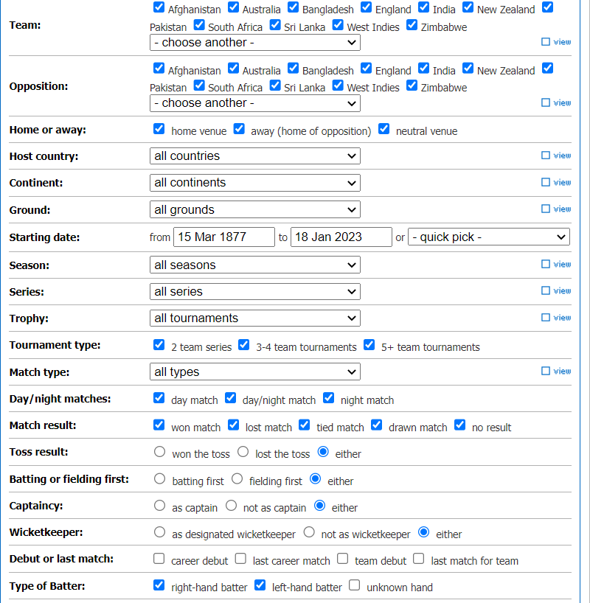
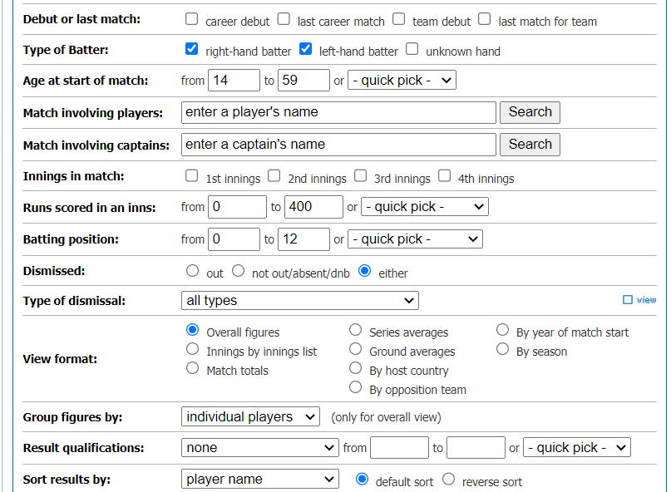
Website
Website used for scraping
URL: https://www.espncricinfo.com/ Gathered data based on these filters

Slide 5
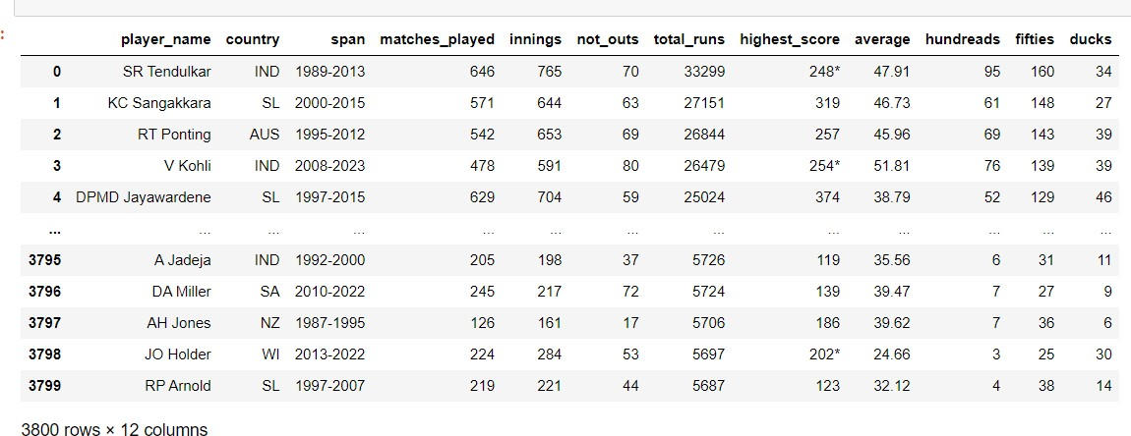
Web scraping
Data obtained after scrapping.
web scraping is done with the request library and from the beautiful soup library in which data is pulled out of HTML code

Slide 6
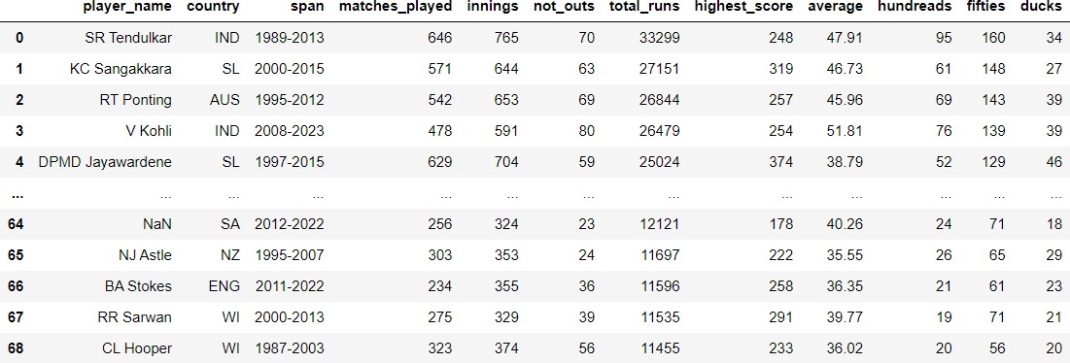
Data cleaning
In the cleaning process removed some rows that don’t have any player name these were replaced by nan and dropped that column using the dropna method and some columns contained unnecessary symbols like(*for not out, + for more than) these were replaced by empty space
Cleaned data

Slide 7
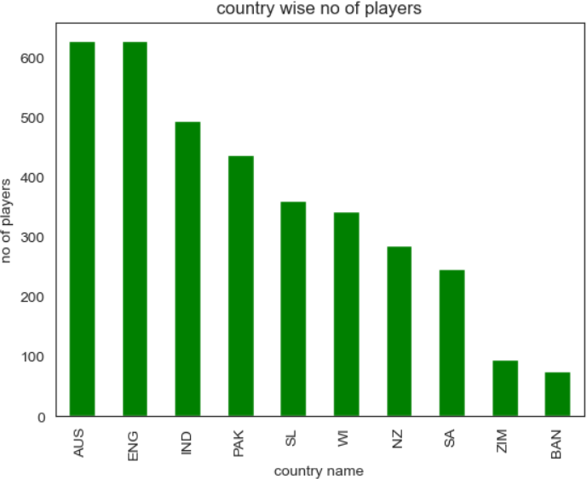
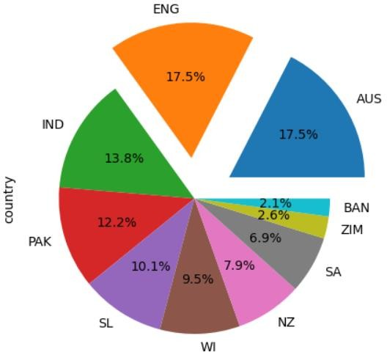
Exploratory Data Analysis [EDA]
After analysing each column I found that data is imbalanced , and contain 10 country players, most no of players from Australia, England and least from Bangladesh.

Slide 8
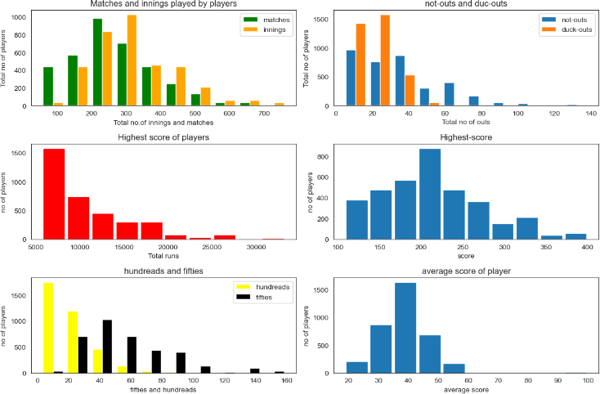
1. Maximum matches played minimum is 52
646 and
Maximum innings played 765 and minimum is 80.
maximum not outs is 139 and minimum is
5.
maximum duck outs 53 and minimum is 4.
maximum total runs 33299 and minimum is 5687.
Maximum highest score 400 and minimum is 108.
Minimum average score is 18 and maximum is 100.
maximum hundreds 95, and minimum is 2.
Maximum fifties 160 and minimum is 13.

Slide 9
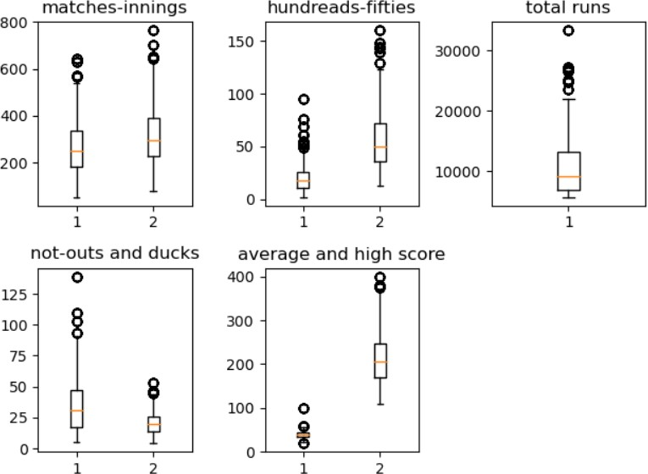
Outliers
IN the data the outliers are important so, not replacing them with mean values.

Slide 10
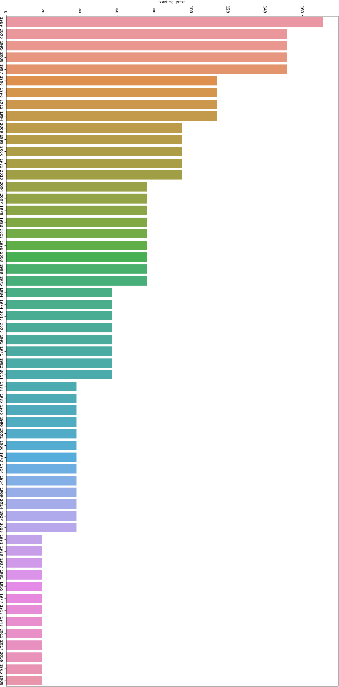
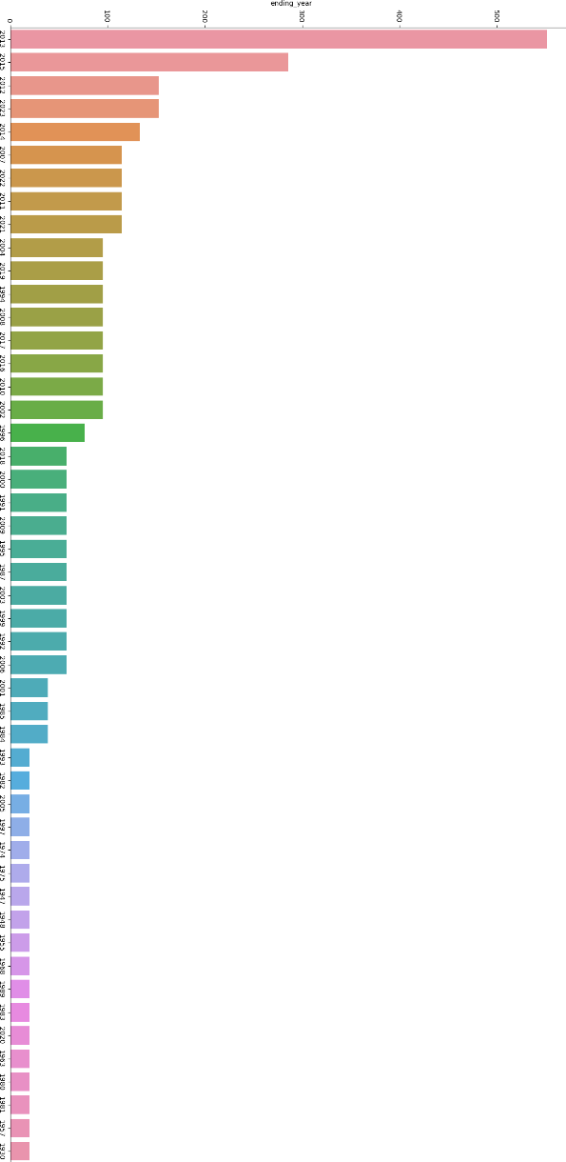
Span
Carrier starting
Maximum-1989 , minimum-1908
Carrier ending
Maximum-2013,minimum-2020

Slide 11
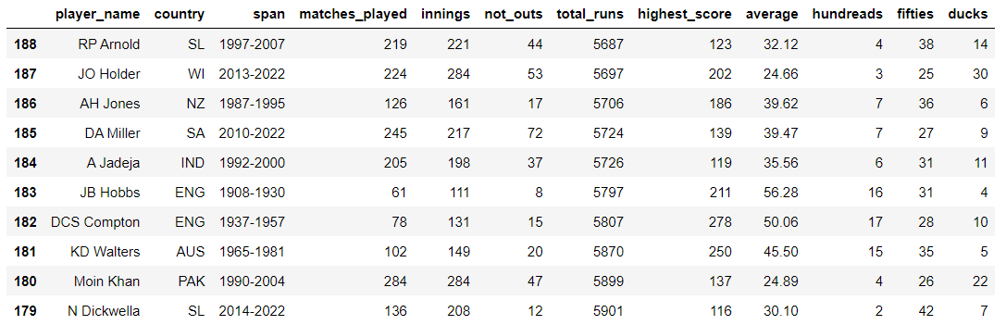
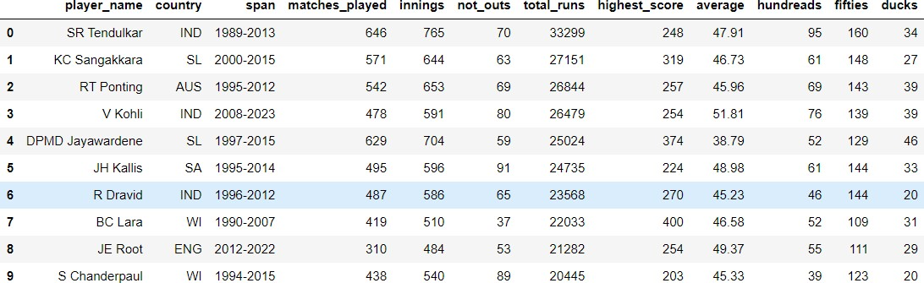
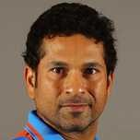
Best and average players in the world
sorted the columns to find best and average player in the order
["total_runs","highest_score","average","hundreads","fifties","matches_played","innings“]
Best players [top 10]
Average players [top 10]
THE best player in the world is
The average player in the world is
SACHIN TENDULKAR
FROM INDIA
N.DICKWELLA
FROM SRI LANKA

Slide 12
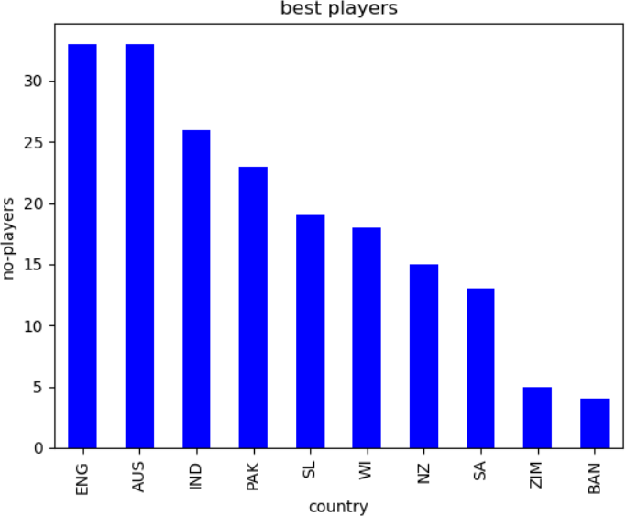
England and Australia has more no of best players and Bangladesh has least no of best players.

Slide 13
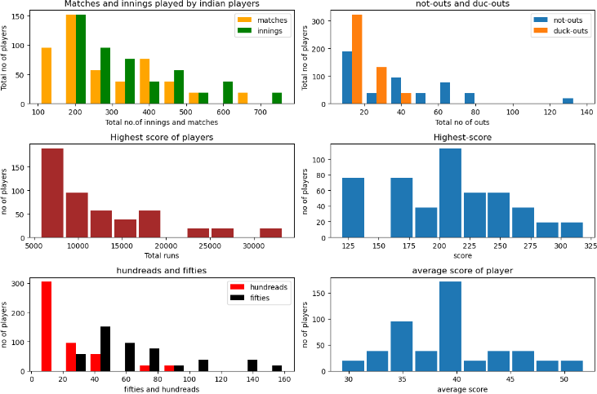
TEAM WISE [INDIA]
Maximum matches played 630 and minimum is 120
Maximum innings played 765 and minimum is 190.
maximum not outs is 130 and minimum is 15.
maximum duck outs 45 and minimum is 17.
maximum total runs 33299 and minimum is 5687.
Maximum highest score 310 and minimum is 123.
Minimum average score is 27 and maximum is 55.
maximum hundreds 85, and minimum is 10.
Maximum fifties 157 and minimum is 30.

Slide 14
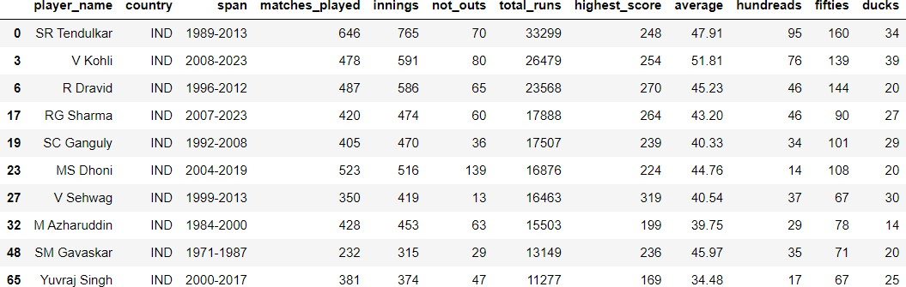
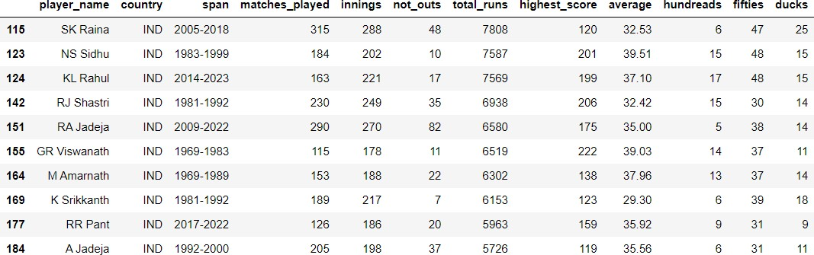
Best and average player in INDIA
Best players [top 10]
Average players [top 10]
THE best player in India is
The average player from India is
SACHIN TENDULKAR
A JADEJA

Slide 15
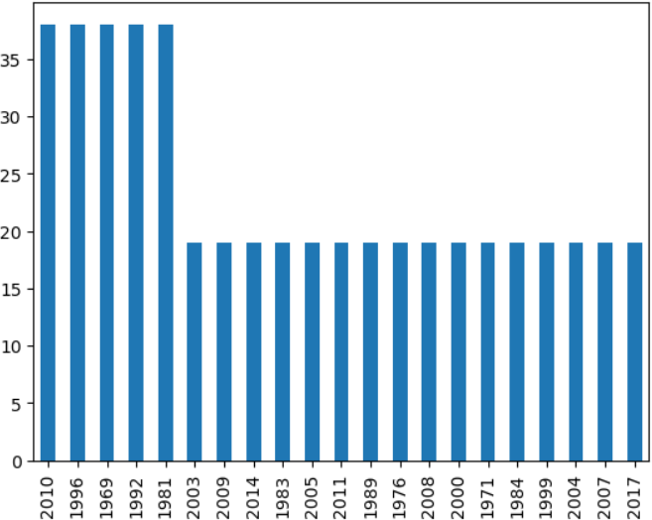
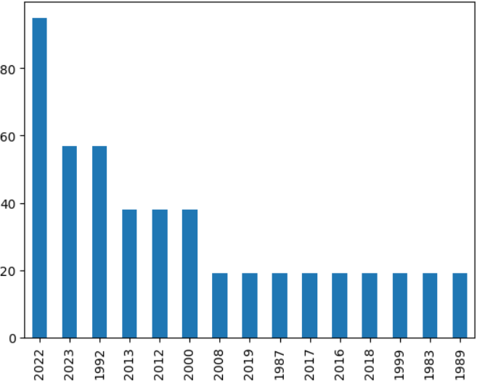
Span
In India most players started their
Most players retired in the year
carrier in the year
2022
1969,1981,1992,1996,2010

Slide 16
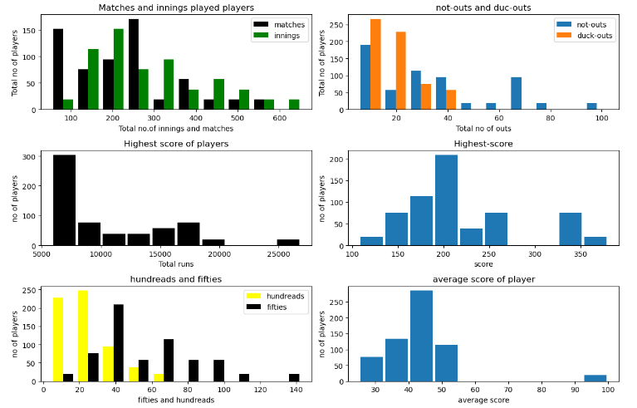
Australia
Maximum matches played is 550 and minimum is 50
Maximum innings played 630 and minimum is 80 .
maximum not outs is 90 and minimum is 15.
maximum duck outs 45 and minimum is 15.
maximum total runs 26844 and minimum is 5500.
Maximum highest score 340 and minimum is
123.
Minimum average score is 25 and maximum is
45.
maximum hundreds 63, and minimum is 10.
Maximum fifties 142 and minimum is 15.

Slide 17
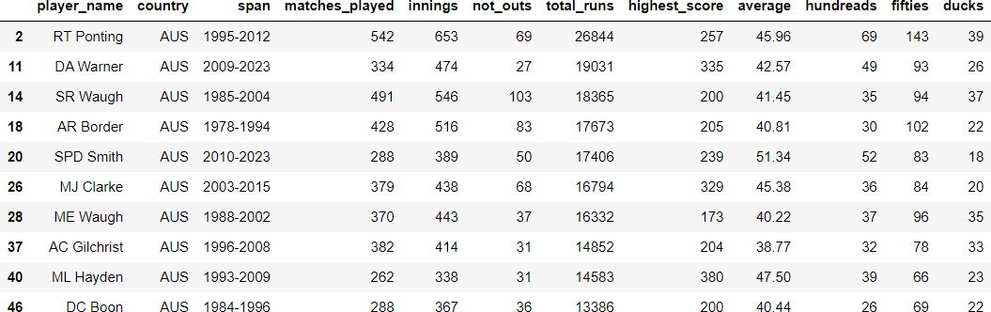
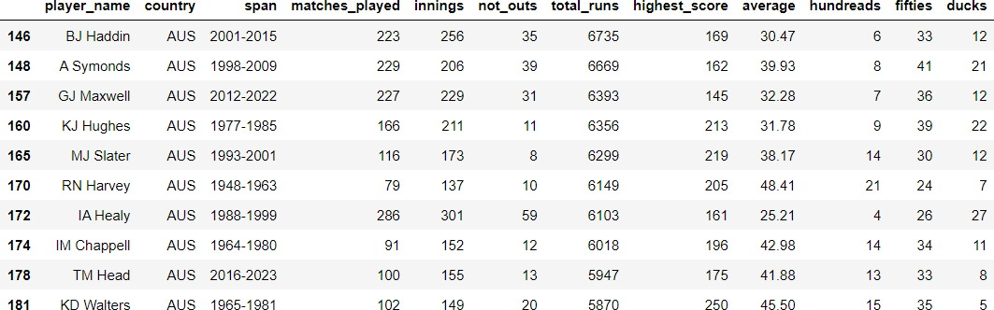
Best and average players in Australia
Best players (top 10) Average players (top 10)
The best player in Australia is
The average player in the Australia
RT PONTING
is
KD WALTERS

Slide 18
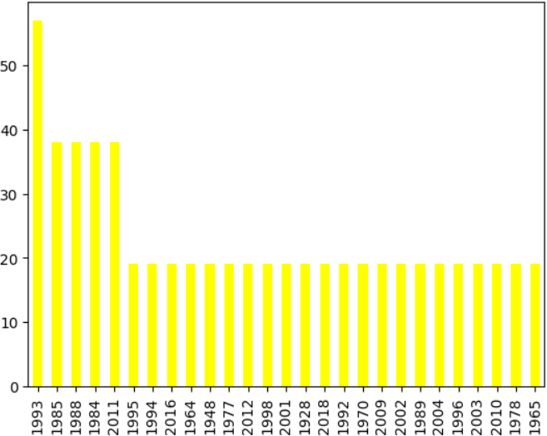
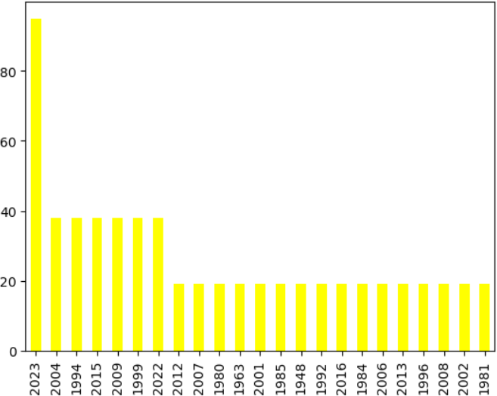
Span
In Australia most players started their carrier in the year 1993
Most players got retired in the year 2023

Slide 19
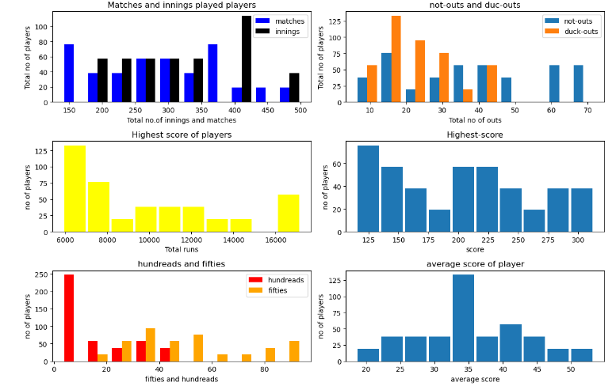
PAKISTAN
Maximum matches played 470 and minimum is
148
Maximum innings played 495 and minimum is
200.
maximum not outs is 69 and minimum is 8.
maximum duck outs 45 and minimum is 11.
maximum total runs 17177 and minimum is 600
Maximum highest score 320 and minimum is 120.
Minimum average score is 18 and maximum is
52.
maximum hundreds 42, and minimum is 8 .
Maximum fifties 90 and minimum is 18.
0.

Slide 20
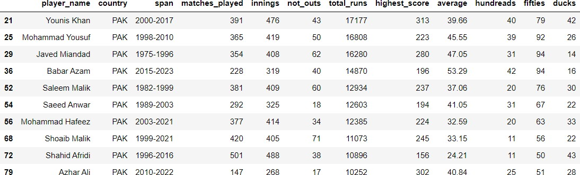
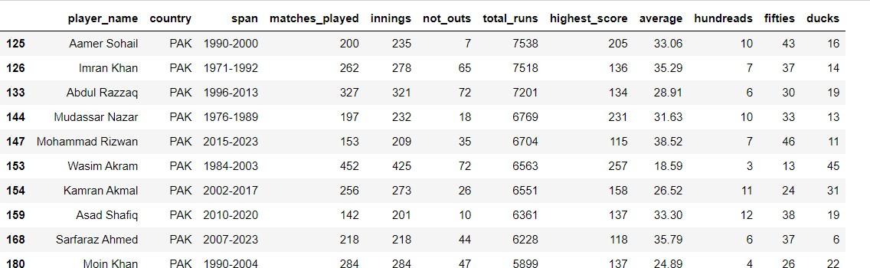
Best and average players in Pakistan
Best players [top 10] Average players [top 10]
The best player from Pakistan is
The average player from Pakistan is
YONISH KHAN
MOIN KHAN

Slide 21
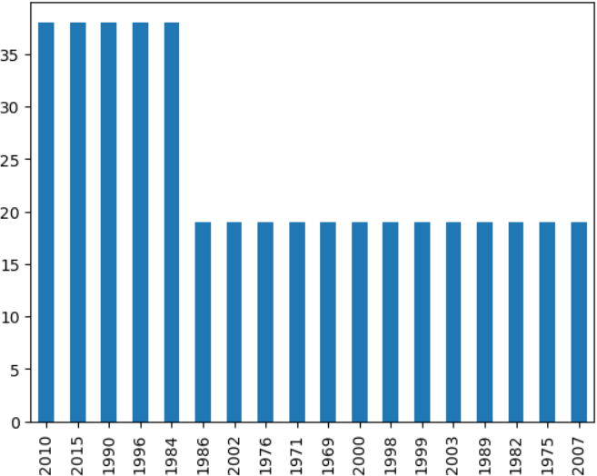
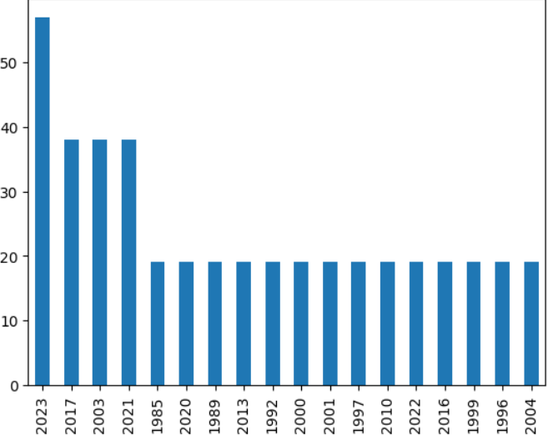
SPAN
MOST players started their carrier in the years 2010,2015,1990,1996
Most players retired in the year 2023.

Slide 22
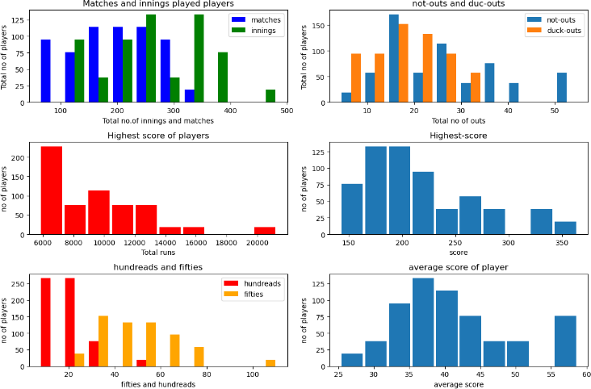
ENGLAND
Maximum matches played 310 and minimum is 61
Maximum innings played 484 and minimum is 111
maximum not outs is 53 and minimum is 4 .
maximum duck outs 45 and minimum is 11.
maximum total runs 21282 and minimum is 5797 .
Maximum highest score 254 and minimum is
211.
Minimum average score is 26 and maximum is 58
maximum hundreds 55 , and minimum is 10
Maximum fifties 110 and minimum is 23.

Slide 23
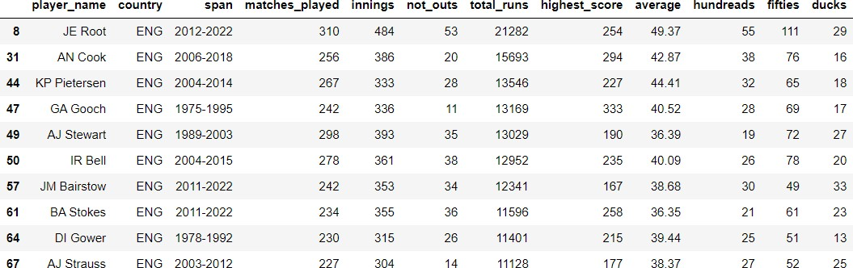
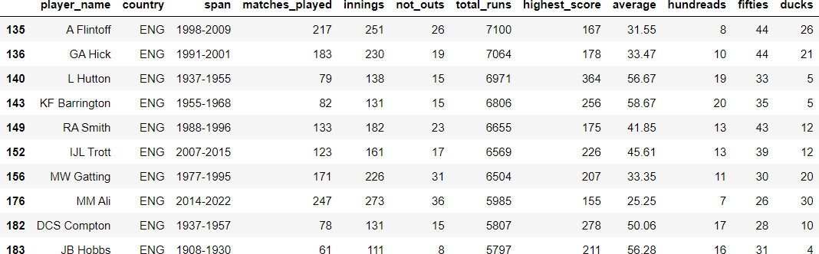
BEST AND AVERAGE PLAYERS FROM ENGLAND
BEST PLAYERS (TOP 10)
AVERAGE PLAYERS (TOP 10)
THE BEST PLAYER IS
JE ROOT
THE AVERAGE PLAYER IS
JB HOBBS

Slide 24
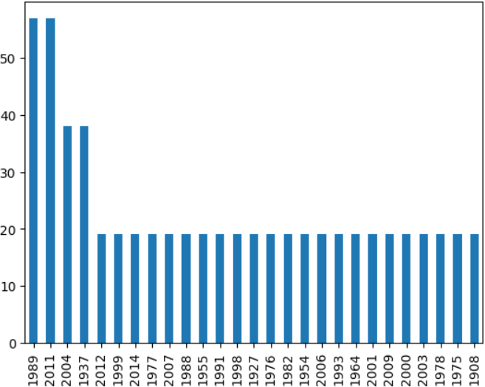
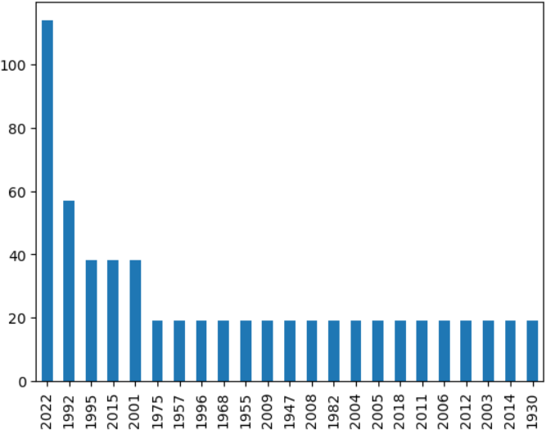
SPAN
MOST PLAYERS STARTED THEIR CARRIOR IN THE YEAR 1989,2011
MOST PLAYERS RETIRED IN THE YEAR 2022

Slide 25
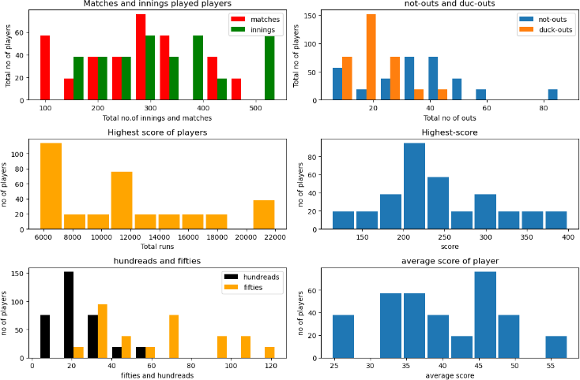
WEST INDIES
Maximum matches played 460 and minimum is 98
Maximum innings played 530 and minimum
is 170
maximum not outs is 85 and minimum is 8.
maximum duck outs 43 and minimum is
12.
maximum total runs 22033 and minimum is 6000 .
Maximum highest score 400 and minimum
is 130.
Minimum average score is 25 and maximum is 58
maximum hundreds 55 and minimum is 10
Maximum fifties 122 and minimum is 21.

Slide 26
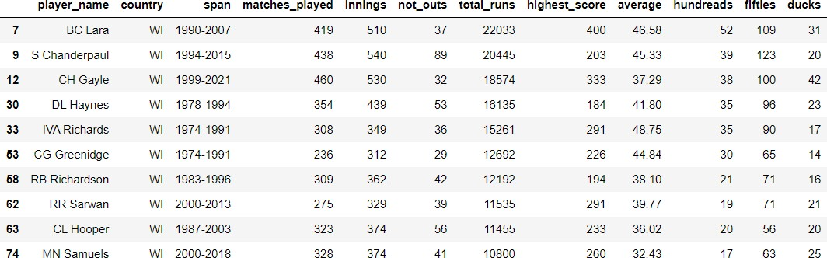
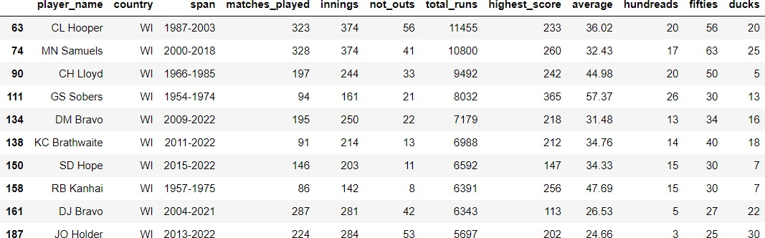
Average and best players from west indies
Best players (top 10)
Average players (top 10)
Average player is
JO HOLDER
Best players is
BC LARA

Slide 27
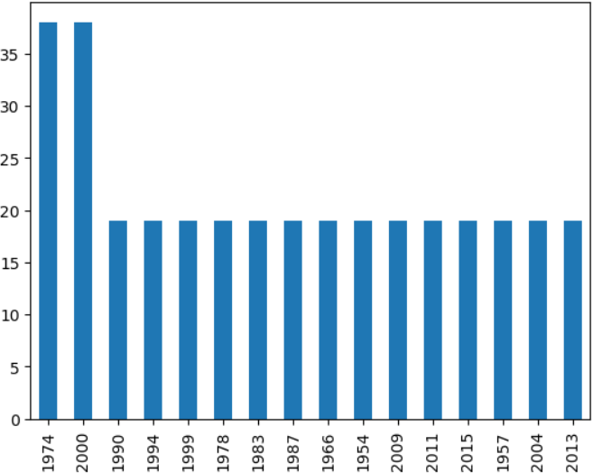
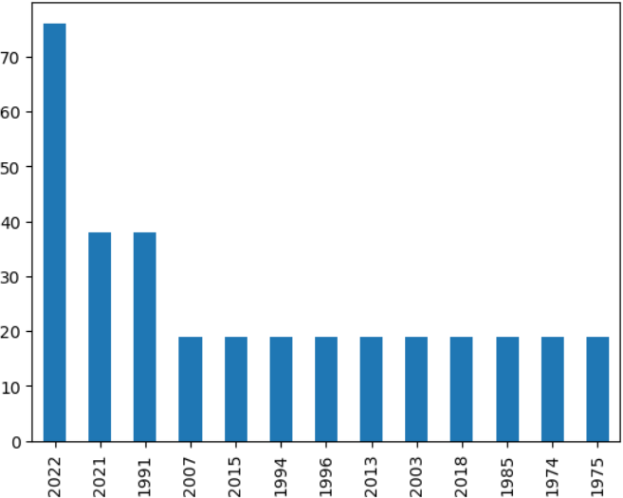
SPAN
Most players started their carrier in the year 1974 , 2000
Most players retired in the year 2022

Slide 28
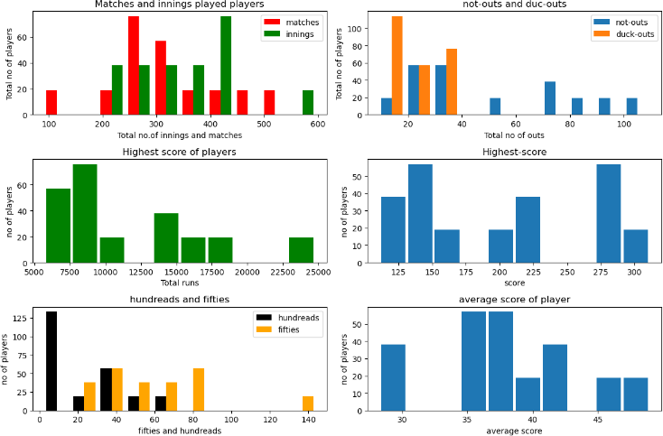
SOUTH AFRICA
Maximum matches played 505 and minimum is 99
Maximum innings played 595 and minimum is 220
maximum not outs is 105 and minimum is 12.
maximum duck outs 35 and minimum is 14.
maximum total runs 24735 and minimum is 5800 .
Maximum highest score 310 and minimum is 110.
Minimum average score is 28 and maximum is 47
maximum hundreds 65 and minimum is 8
Maximum fifties 143 and minimum is 25.

Slide 29
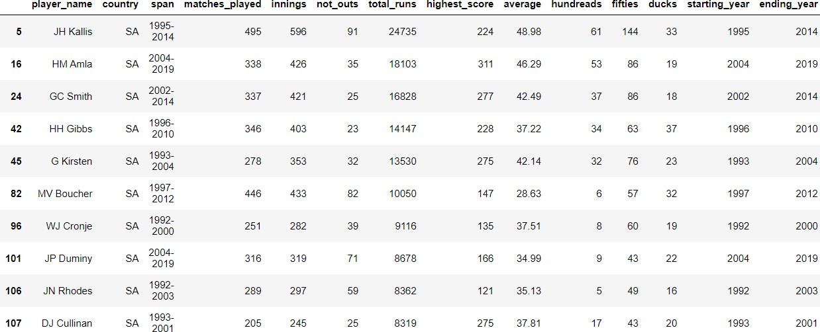
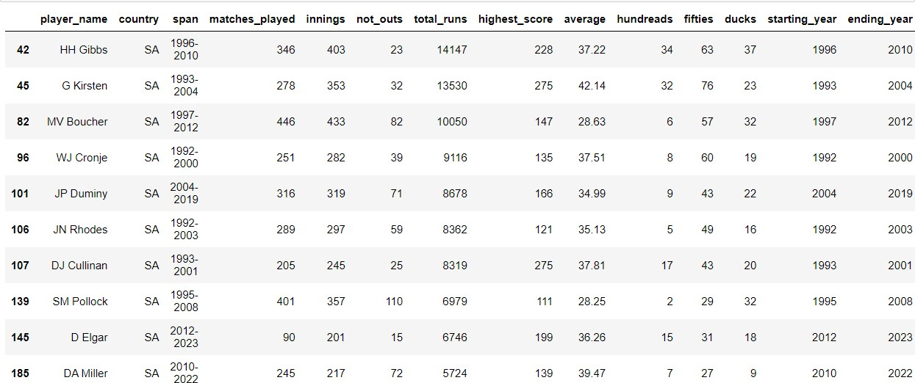
Best and average players from south Africa
Best players (top 10)
Average players (top 10)
Best player is
JH KALIS
AVERAGE PLAYER IS
DA MILLER

Slide 30
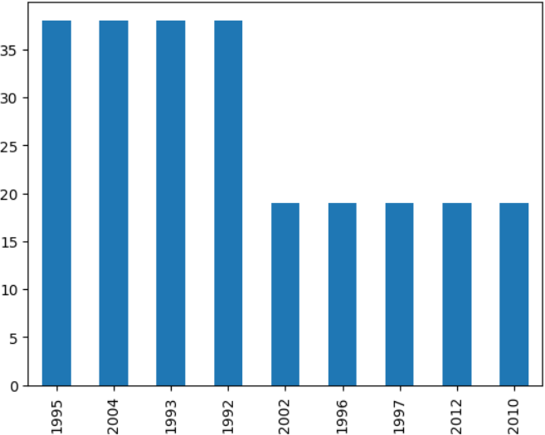
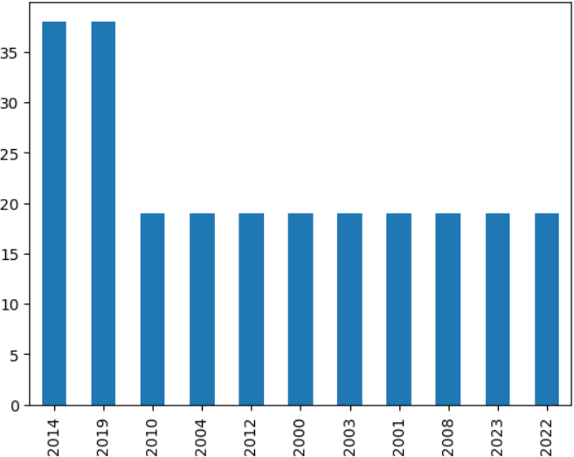
SPAN
MOST PLAYERS STARTED THEIR CARRIER IN THE YEAR
MOST PLAYERS RETIRED IN THE YEAR 2014,2019
1995,2004,1993,1992

Slide 31
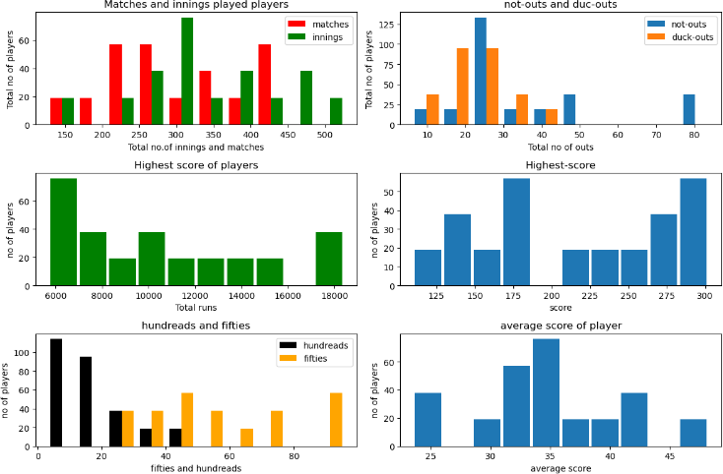
NEWZELAND
Maximum matches played 436 and minimum is 135
Maximum innings played 527 and minimum is 150
maximum not outs is 84 and minimum is 8.
maximum duck outs 29 and minimum is 11.
maximum total runs 18398 and minimum is 5900 .
Maximum highest score 290 and minimum is 110.
Minimum average score is 23 and maximum is 48
maximum hundreds 50 and minimum is 7
Maximum fifties 95 and minimum is 30.

Slide 32
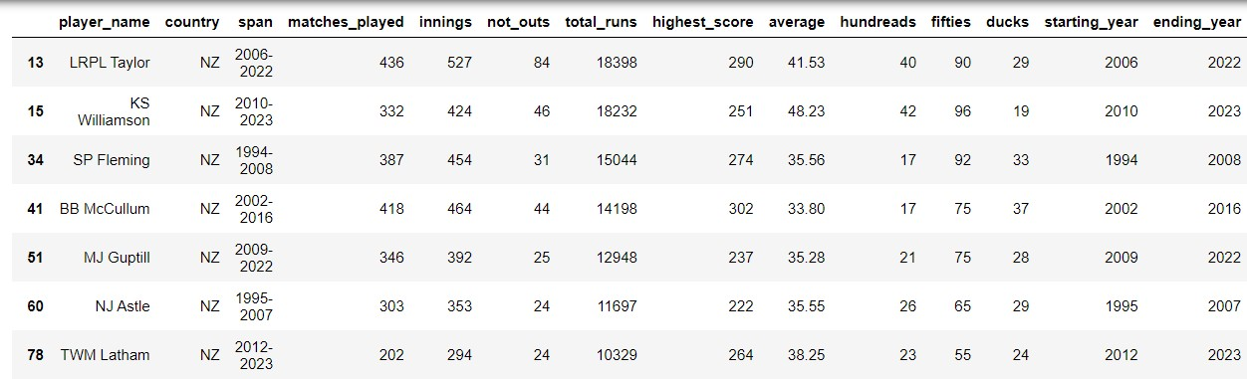
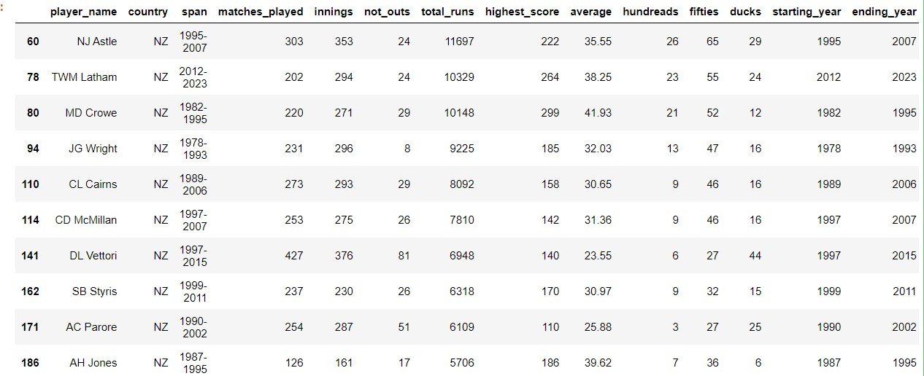
BEST AND AVERAGE PLAYER FROM NEZELAND
BEST PLAYERS (TOP 10) AVERAGE PLAYERS (TOP 10)
BEST PLAYER IS
LRPL TAYLOR
AVERAGE PLLAYER IS
AH JONES

Slide 33
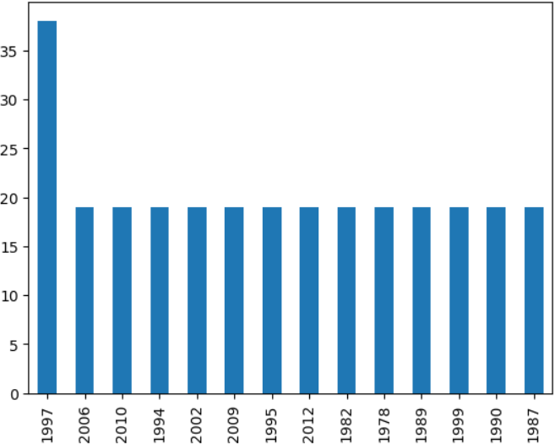
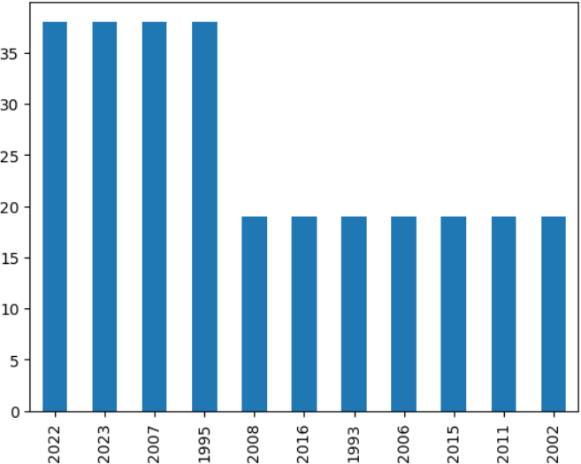
SPAN
MOST PLAYERS STARTED THEIR CARRIER IN THE YEAR 1997
MOST PLAYER RETIRED IN THE YEAR 2022,2023,2007,1995

Slide 34
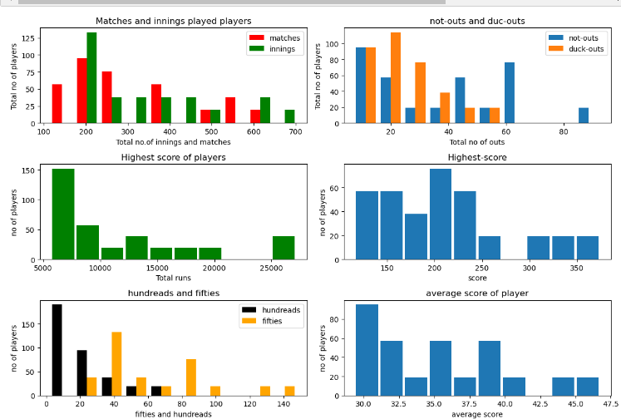
Sri LANKA
Maximum matches played 571 and minimum is 110
Maximum innings played 644 and minimum is 210
maximum not outs is 63 and minimum is 8.
maximum duck outs 27 and minimum is
18.
maximum total runs 27151 and minimum is 5200 .
Maximum highest score 370 and minimum is 130.
Minimum average score is 46 and maximum is 29
maximum hundreds 65 and minimum is 7
Maximum fifties 145 and minimum is 25.

Slide 35


BEST AND AVERAGE PLAYER FROM Sri LANKA
BEST PLAYERS (TOP 10)
AVERAGE PLAYERS (TOP 10)
BEST PLAYER
KC SANGAKKARA
AVERAGE PLAYER IS
RP ARNOLD

Slide 36


SPAN
MOST PLAYERS STARTED THEIR CARRIER IN THE YEARS 1997,2010,1986
MOST PLAYERS RETIRED IN THE YEAR 2022

Slide 37

Bangladesh
Maximum matches played is 400 and minimum is 160
Maximum innings played 490 and minimum is 245 .
maximum not outs is 70 and minimum is 10.
maximum duck outs 37 and minimum is 19.
maximum total runs 15016 and minimum is 5000.
Maximum highest score 219 and minimum is
170.
Minimum average score is 23 and maximum is
35
maximum hundreds 20, and minimum is 8.
Maximum fifties 95 and minimum is 30.

Slide 38

BEST AND AVERAGE PLAYERS FROM BANGLADESH
BEST PLAYERS (TOP 10) AVERAGE PLAYERS ( TOP 10)
BEST PLAYER IS
TAMIN IQBAL
AVERAGE PLAYER IS
MOHAMMAD
ASHRAFUL

Slide 39


SPAN
MOST PLAYERS STARTED THEIR CARRIER IN 2001,2015,2005,2007
MOST PLAYERS RETIRED IN THE YEAR 2022

Slide 40

Zimbabwe
Maximum matches played is 270 and
minimum is 220
Maximum innings played 320 and minimum is 285 .
maximum not outs is 33 and minimum is 7.
maximum duck outs 34 and minimum is 19.
maximum total runs 10862 and minimum is 7500.
Maximum highest score 225 and minimum is
130.
Minimum average score is 23 and maximum is
39
maximum hundreds 18, and minimum is 10.
Maximum fifties 73 and minimum is 45.

Slide 41

BEST AND AVERAGE PLAYERS FROM ZIMBABWE
BEST PLAYERS (TOP 10) AVERAGE PLAYERS (TOP 10)
BEST PLAYER IS
A FLOWER
AVERAGE PLAYER IS
ADR CAMPBELL

Slide 42


SPAN
MOST PLAYERS STARTED THEIR CARRIER IN THE YEAR 1992
MOST PLAYERS RETIRED IN THE YEAR 2002,2003,2010,2019, 2021

Slide 43


BEST TEAM
INDIA IS TOP IN MORE THAN 4 FEATURES
OUT OF 11 SO INDIA IS THE BEST TEAM

Slide 44









Top Player from all the countries
SR TENDULKAR IND
RT PONTING AUS
YOUNIS KHAN PAK JE ROOT ENG JH KALLIS SA
LRPL TAYLOR NZ
KC SANGAKKARA SL
•
•
•
THAMIM IQBAL BAN
•
•
A FLOWER
ZIM
•
•
•
BC LARA
WI
•

Slide 45
Average players in all countries
ADR CAMPBELL ZIM
MOHAMMAD ASHRAFUL BAN
RP ARNOLD SL
AH JONES NZ
DA MILLER SA
JO HOLDER WI
JB HOBBS ENG
MOIN KHAN PAK
DC BOON AUS
A JADEJA IND

Slide 46

Conclusion [player] :-
from the above plot we say that average and matches played are
negatively corelated
the player highest score and not outs are in negatively corelated,
With my analysis concluding that players has to maintain good average in every match to become top and best layer in the world.
most of the players got out after reaching high –score so player have to stay stable after reaching high score

Slide 47
Conclusion (team ):-
India : Indian players has to decrease the duck out counts to become best team after some years.
Australia : has to maintain good average increase the high score and total runs.
Pakistan : has to increase high-score and total runs matches played.
England : has to increase matches played ,total runs , high score.
West indies : has to increase matches played and total runs.
South Africa : has to increase high score , total runs average,matches played.
Newzeland : has to increase matchesplayed, average, total runs , highest score.
Sri lanka : has to increase highest score total runs average.
Bangladesh : has to imcrease high score , total runs average centuries , player count
Zimbabwe : total runs centuries fifties matches played and has to decrese the duck outs,player count

Slide 48

Q&A
THANK YOU

